Slide 1
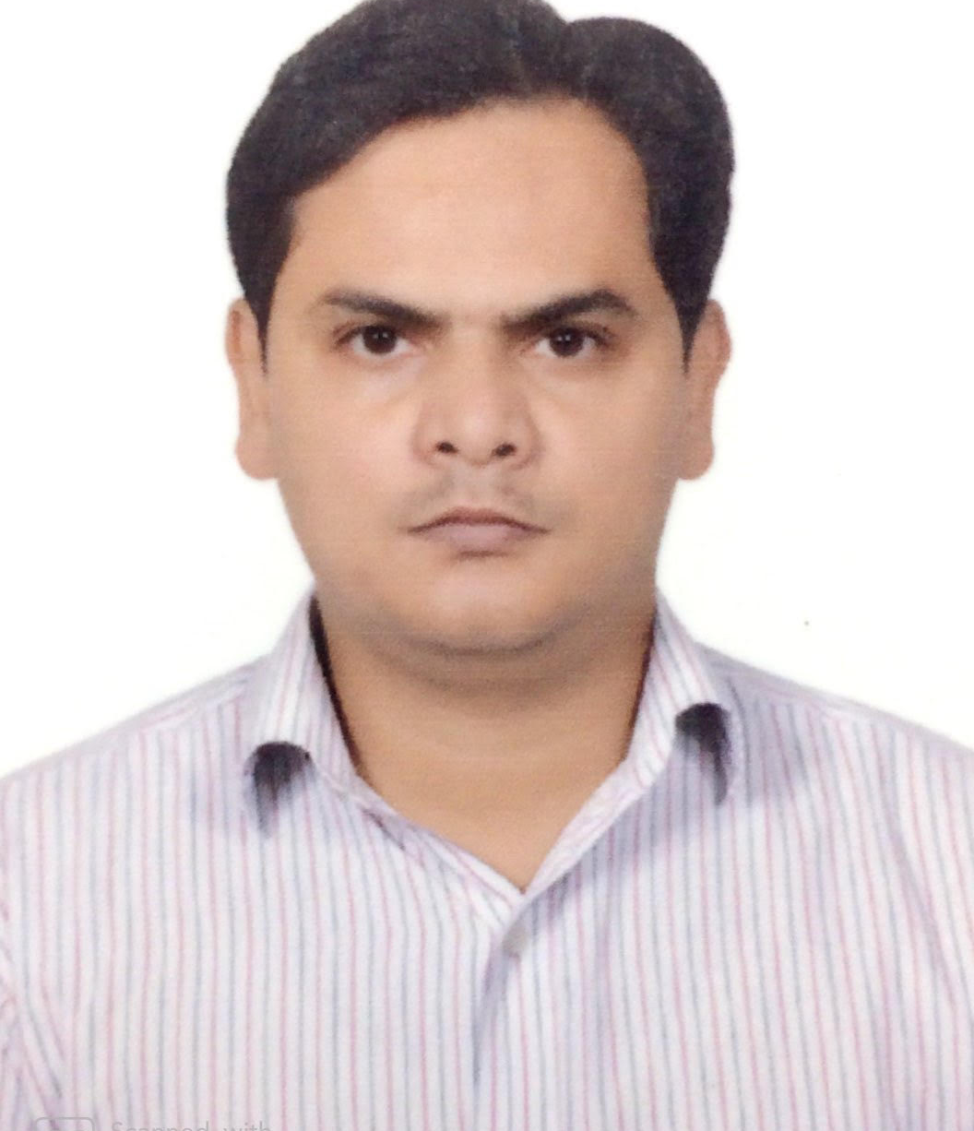
Application Development Assoc Manager
Ram Prakash Singh
Application Development Assoc Manager
ram.prakash.singh@accenture.com
+91 9953875097
Business On Line(Corporate banking) – Bank Of Ireland Client. Location: Ireland.
Tech lead and Sr. Engineer for Corporate Banking web application analysis, design and development for scrum team. Agile software develoment methodology.
Tech stack such as Java, Spring,Oracle, Coolgen, Mainframe etc.
Machine to Machine – Yanmar Agriculture Equipment Client . Location: Japan & India.
Tech lead and Sr Engineer for AWS IOT based application for a scrum team. Agile software development methodology. Tech stack Java, AWS, Docker etc.
Learning Objective Management Tool – Pearson Client. Location UK & North America.
Sr. Engineer for microservices application analysis, design and development. Tech stack such as Java, Microservices, SpringBoot, MarkLogic DB etc.
Socrates - Specsaver Optical Group Ltd Client. Location UK, Australia, Nederland
Part of Product development scrum team, Tech stack such as Java, Spring, Hibernate, SOAP WS etc.
9+ years experience in design and implementation of web application, object oriented, frameworks & cloud architecture in various business domains. Experienced in managing, leading development, test driven development, product development.
Experienced in Java, AWS, Microservices, Docker, Restful web service, Spring/Spring boot, Hibernate, JPA, Apache Tomcat, JBOSS, version control, build and deployment tools, SQL/NO-SQL databases, Selenium.
Java & Opensource Technolgoies
Container – Docker
Cloud Computing:AWS
SQL/No-SQL DB
Retail
Banking & Mortgage Insurance
Publishing
Oil & Gas
E-Commarce

